Slide 1

SHORT PRESENTATION FOR QUIZ ASSIGNMENT
ARTEMIS SEVASTIADI

Slide 2
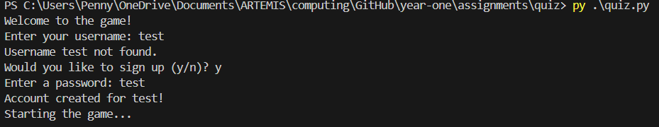
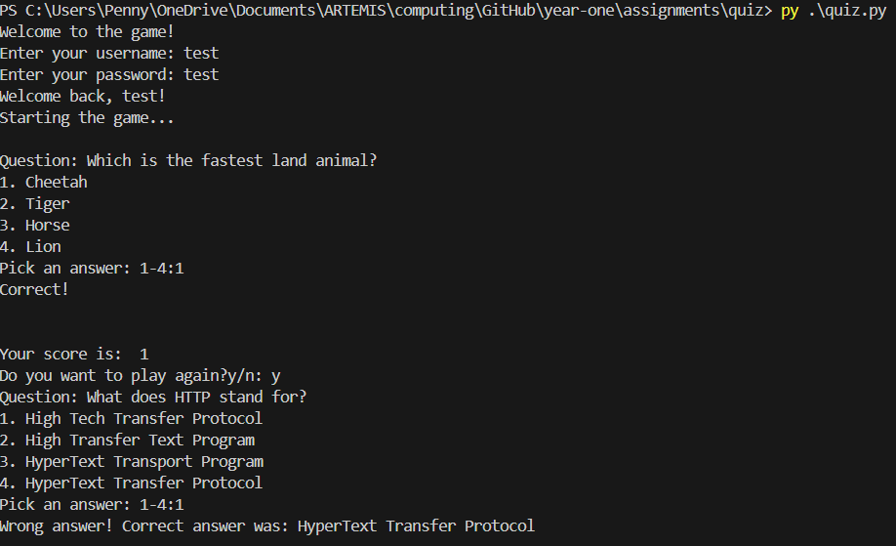
Creating a user, sign up, log in
In this, initial part of the program we ask the user if they want to log in/ sign up, creating them an account. I used four different functions for loading users, save users, log in and sign up. After sign up, the username and password is stored on a text file and will be used when the user tries to log in, as we can see on the second picture.

Slide 3
Core part, quiz game (part 1)
After the user logs in the game starts and the questions are presented to the user. For this to happen, I created a text file with some questions and read the file in the running program. After I shuffled the possible answers and all the questions of the file, I print to the user the questions and the possible answers enumerated, so that it can be easier for the user to pick.

Slide 4
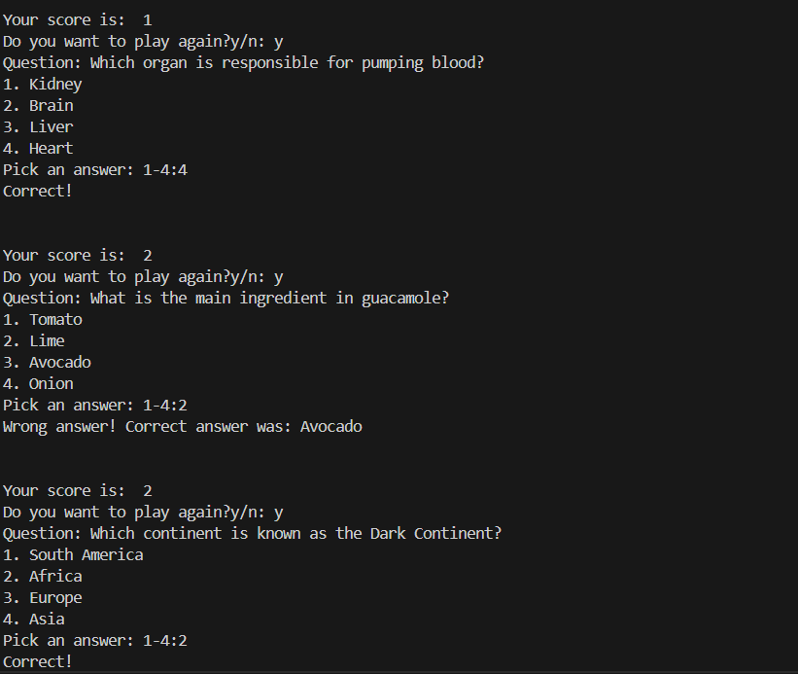
Core part, quiz game (part 2)
The game works with a big for loop that has all the if statements stored. As the game continues the game prints the user’s score, while storing it on a different text file with the usernames and the scores. Each correct answer is one point. I also print if the user picked the correct answer or not. As we can see on the picture, if the user picked the wrong answer, I am displaying the correct one.

Slide 5
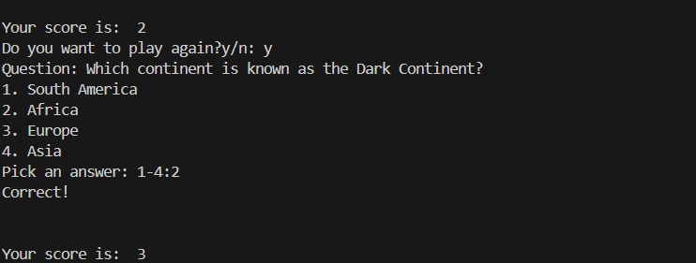
Core part, quiz game (part 3)
The scores of the users are appended on a different on the text files with a function. When five questions are presented to the user, the game exits. For this to happen, I restricted the for loop to work only if the questions are equal or less than 5.

